Slide 1
PRIORITY ASSIGNMENT FOR GLOBAL FIXED PRIORITY PRE-EMPTIVE SCHEDULING IN MULTI-PROCESSOR REAL-TIME SYSTEMS
Pavan Kumar
Tejah S S

Slide 2
Overview
In the case of uniprocessor processing, research on fixed task scheduling algorithms led to the discussion of the optimality of RMPO, DMPO, and Audsley's OPA.
Global FP scheduling – dhall effect - tkc, threshold-based approaches
Schedulability tests for sporadic task sets are developed from necessary unschedulability tests. (Implemented in paper)
Optimal scheduling algorithms in uniprocessor scenario is no longer optimal in multi-processor case.(DMPO)

Slide 3
Introduction

Slide 4
PROBLEM STATEMENT
The goal is to schedule sporadic tasks with constrained deadlines using global FP scheduling algorithms.
Audsley’s OPA, originally developed for uniprocessor, is used on multi-core platform and produced feasible schedule when schedulability algorithm satisfies three conditions.
Sufficient schedulability tests are developed namely, deadline analysis test and response time analysis test.
Heuristics are generated to generate priority ordering - DkC and D-CMPO.

Slide 5
Definitions
Global FP feasible – priority ordering of task sets using global FP scheduling algorithms such that, tasks can be scheduled without missing the deadlines.
Sufficient schedulability test - deemed to be schedulable are actually schedulable.
Necessary schedulability test – deemed to be unschedulable are infact unschedulable.
Exact schedulability test a – both sufficient and necessary
Optimal priority assignment policy – schedulability test and task model.

Slide 6
Schedulability tests

Slide 7
Model and Schedulability tests
Consider an interval called problem window, at the end of which deadline of a task is missed. Interval from release time of a job to its deadline.
A necessary condition is imposed so that job misses its deadline.
One such condition can be all processors are busy executing for more than (deadline - execution time) duration.
Calculate the maximum interference due to higher priority jobs on particular task in considered problem window and develop a necessary unschedulability test.
Then, develop sufficient schedulability test by negating it.

Slide 8
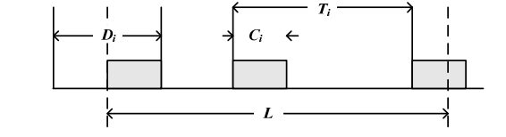
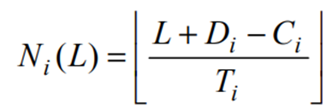
Deadline Analysis Test
•Considering a job of task, maximum interference due to all higher priority tasks is calculated.
•The maximum number of jobs of a higher priority task that can be run in a problem window is given by:
•here, slack time captures part executions of jobs in the problem window, which effectively equals the execution time of the job.

Slide 9

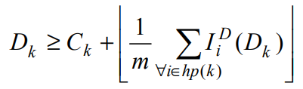
Continued...
•The total workload of a higher priority task in the problem window is given by:
•If a task k is schedulable, then the upper bound on the interference is given by:
Calculating the upper bound interference and distributing it to m processors results in the condition for schedulability.

Slide 10
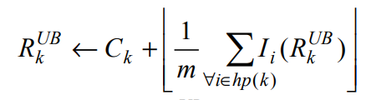

Response Time Analysis
It is an iterative process, where upper bound response time of a task is calculated using upper bound response times of higher priority tasks.
Here, worst case response time is calculated and is compared against deadline to check its schedulability.
The inequality modified as:
Interference is given by:
Workload calculation is same as in deadline analysis test.
If worst case response time converges and is less than deadline, then the task is said to be schedulable.

Slide 11
Priority assignment algorithms

Slide 12
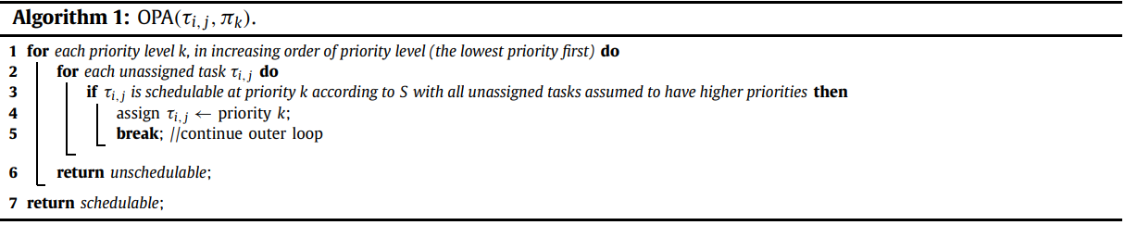
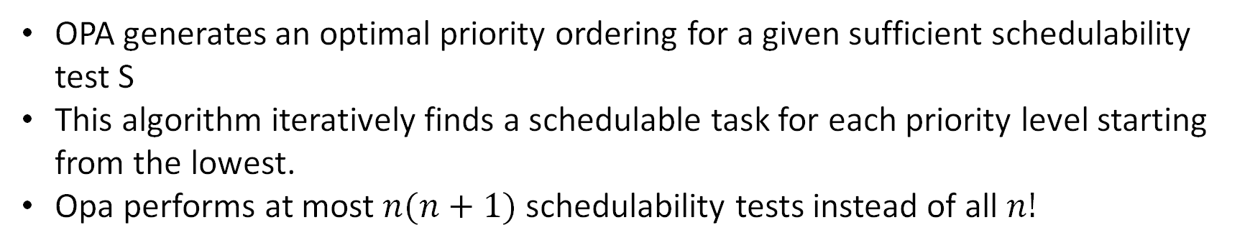
Audsley’s Optimal Priority Assignment
R. Garibay-Martínez et al. (2015)
OPA generates an optimal priority ordering for a given sufficient schedulability test S
This algorithm iteratively finds a schedulable task for each priority level starting from the lowest.
Opa performs at most $n(n+1)$ schedulability tests instead of all $n!$

Slide 13
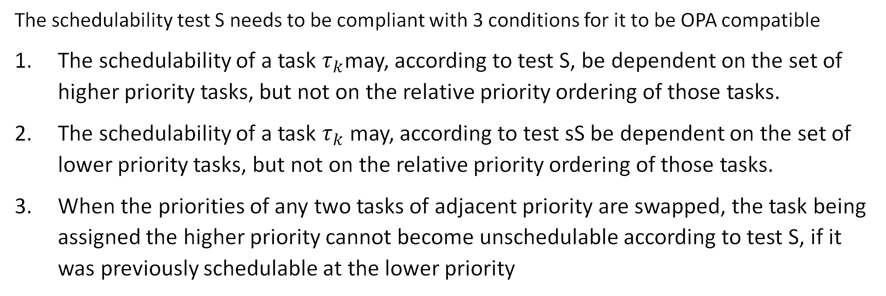
Conditions on s
The schedulability test S needs to be compliant with 3 conditions for it to be OPA compatible
The schedulability of a task $τ_{k}$may, according to test S, be dependent on the set of higher priority tasks, but not on the relative priority ordering of those tasks.
The schedulability of a task $τ_{k}$ may, according to test sS be dependent on the set of lower priority tasks, but not on the relative priority ordering of those tasks.
When the priorities of any two tasks of adjacent priority are swapped, the task being assigned the higher priority cannot become unschedulable according to test S, if it was previously schedulable at the lower priority

Slide 14
Observations
Deadline analysis (DA) mentioned earlier complies with all three conditions and hence is “OPA compatible”
Response time analysis (RTA) on the other hand is not OPA compatible since it is an exact schedulability test
An exact schedulability test by definition violates condition 1.

Slide 15
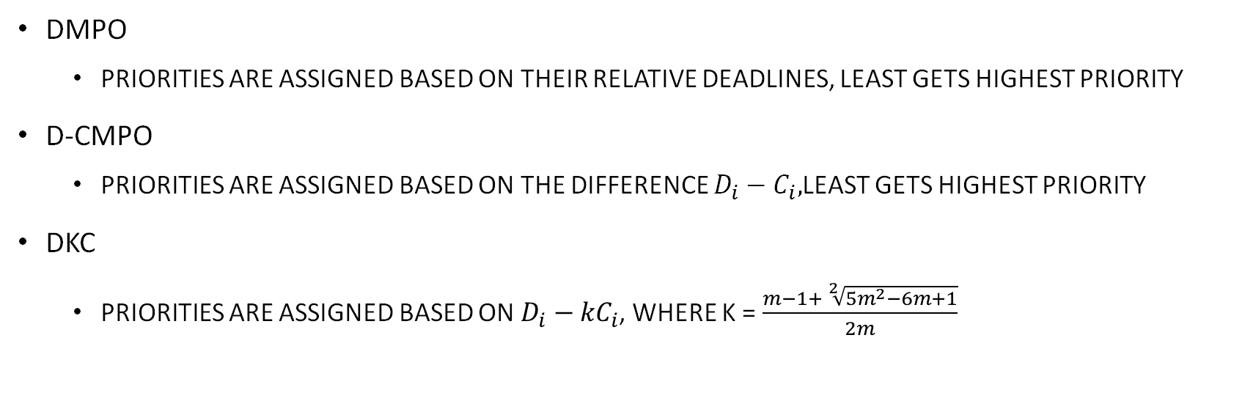
Heuristic priority orderings
DMPO
Priorities are assigned based on their relative deadlines, least gets highest priority
D-CMPO
Priorities are assigned based on the difference $D_{i}−C_{i},$least gets highest priority
DkC
Priorities are assigned based on $D_{i}−{kC}_{i}$, where k = $\frac{m−1+ \sqrt[2]{{5m}^{2}−6m+1}}{2m}$

Slide 16
Taskset generation

Slide 17
Taskset generation
A slight modification of the UUnifast algorithm was used to generate tasksets
Uunifast is used since it runs in O(n) time and generates uniform tasksets
We generate a constrained deadline, sporadic taskset

Slide 18
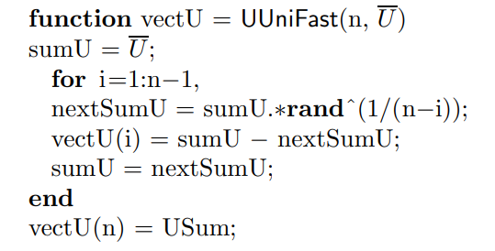
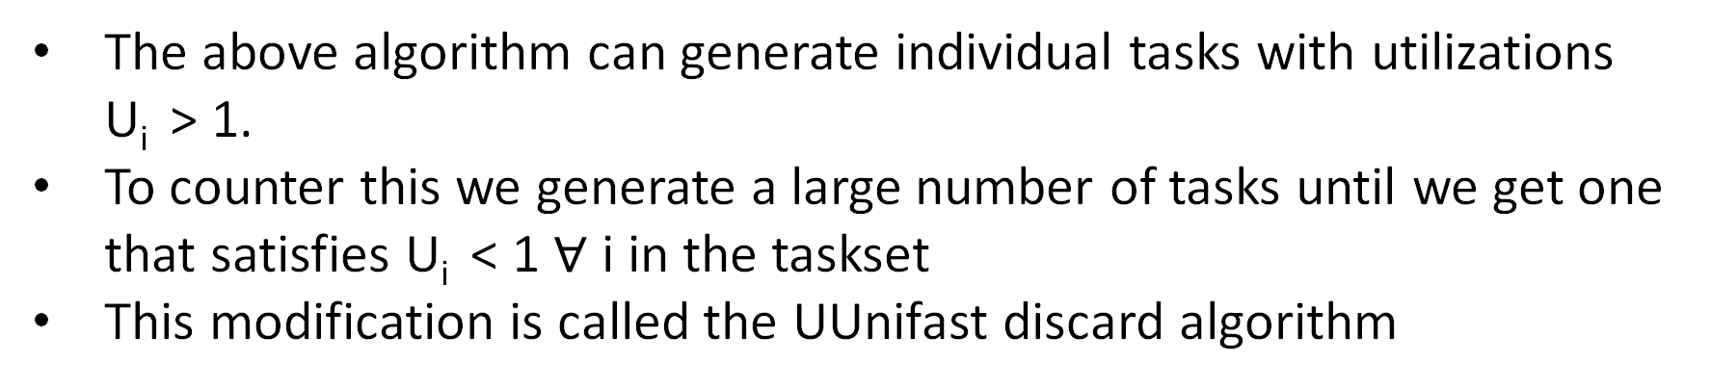
Continued..
The above algorithm can generate individual tasks with utilizations U_{i} > 1.
To counter this we generate a large number of tasks until we get one that satisfies U_{i} < 1 $∀$ i in the taskset
This modification is called the UUnifast discard algorithm

Slide 19
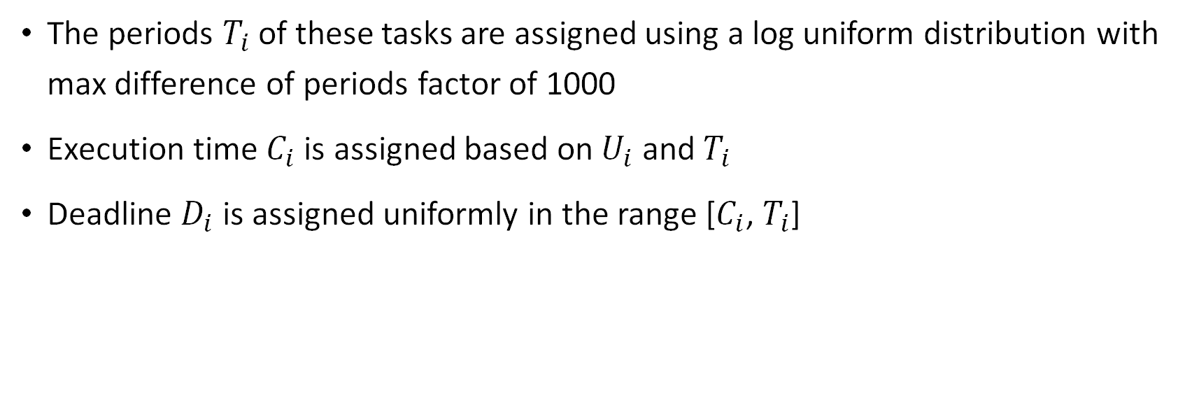
Continued…
The periods $T_{i}$ of these tasks are assigned using a log uniform distribution with max difference of periods factor of 1000
Execution time $C_{i}$ is assigned based on $U_{i}$ and $T_{i}$
Deadline $D_{i}$ is assigned uniformly in the range [$C_{i}$, $T_{i}$]

Slide 20
REsults

Slide 21
Experiment description
The goal is to find out how effectively the algorithms finds a schedule for a given taskset
To find this, a number of tasksets are generated for each utilization and the percentage of these tasks that are schedulable according to the algorithms are plotted
The process is repeated for different number of cores

Slide 22
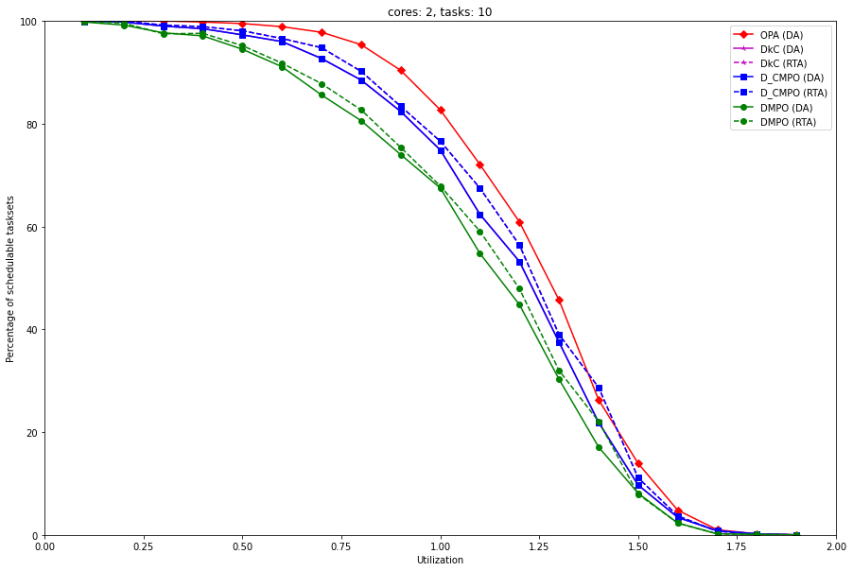
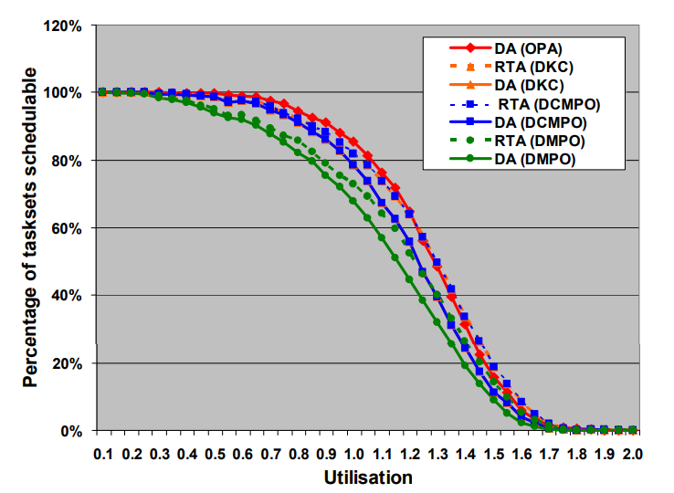
Results for 2 core system with 10 tasks
Plot of percentage of tasksets schedulable(out of 1000) vs Utilization
Our result
Result in the paper

Slide 23
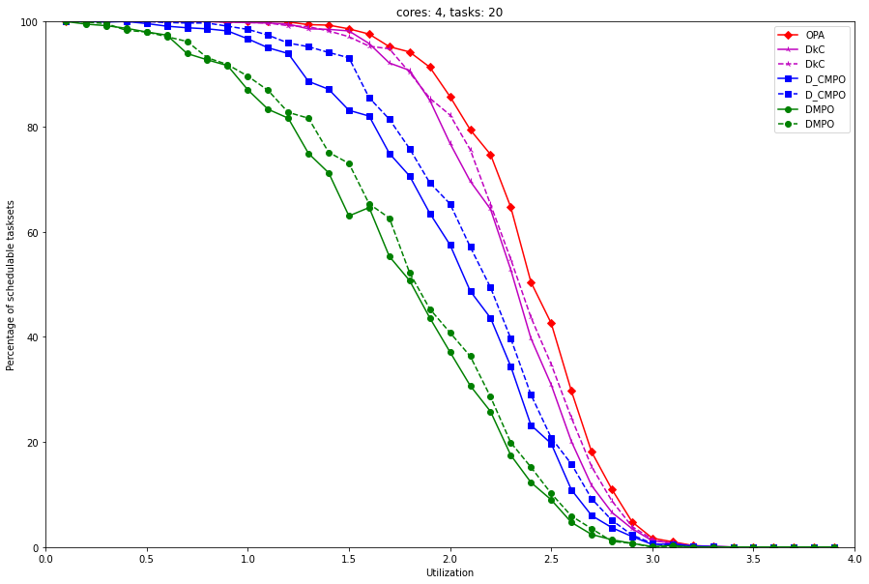
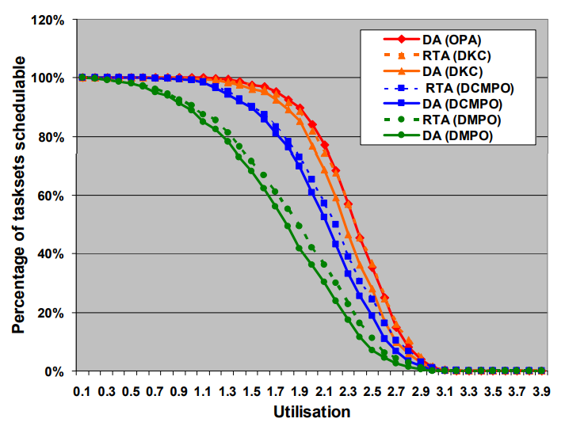
Results for 4 core system with 20 tasks
Plot of percentage of tasksets schedulable(out of 1000) vs Utilization
Our result
Result in the paper

Slide 24
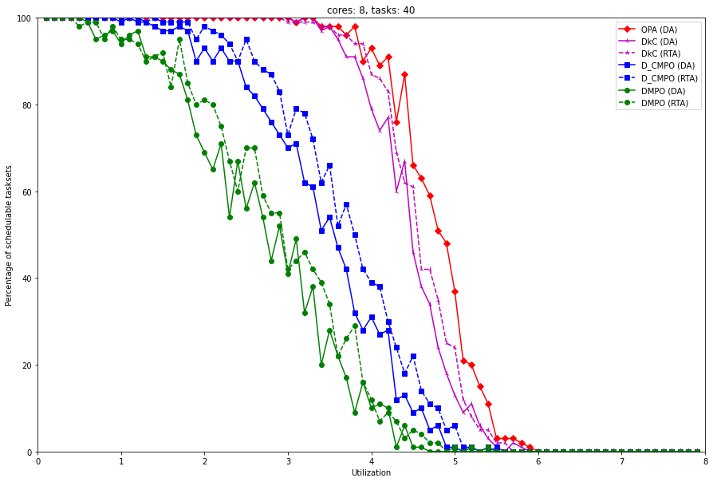
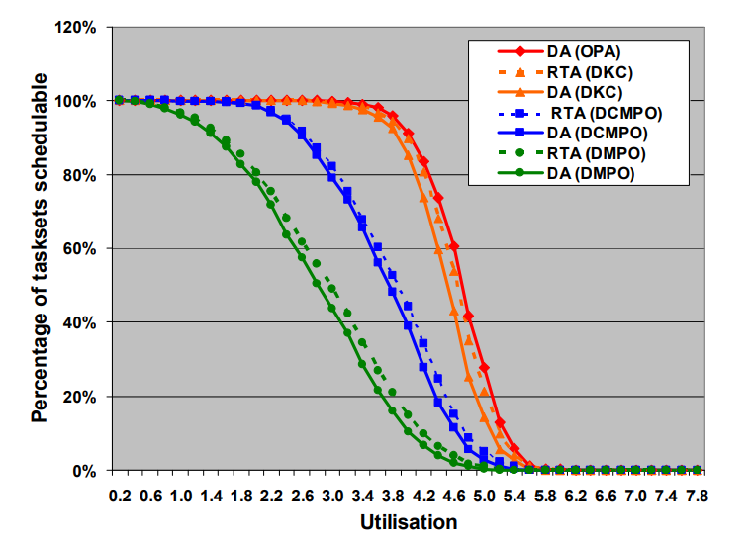
Results for 8 core system with 40 tasks
Plot of percentage of tasksets schedulable(out of 100) vs Utilization
Our result
Result in the paper

Slide 25
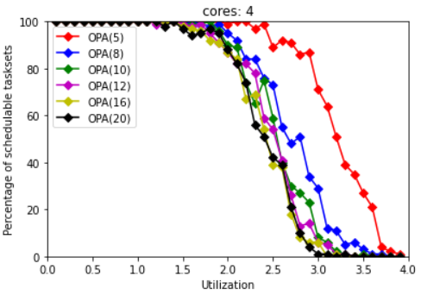
Experiment 2 description
This experiment looks at the effect of the number of tasks in each taskset on the percentage of schedulable tasksets

Slide 26
Conclusion
We observe that OPA gives the highest percentage of tasks scheduled for a given utilization
Although this doesn’t prove optimality of OPA graphically, it shows that we get feasible schedules with OPA when the other heuristics fail.

Slide 27
Thank you

